Slide 1
Notes:
No logo

Slide 2
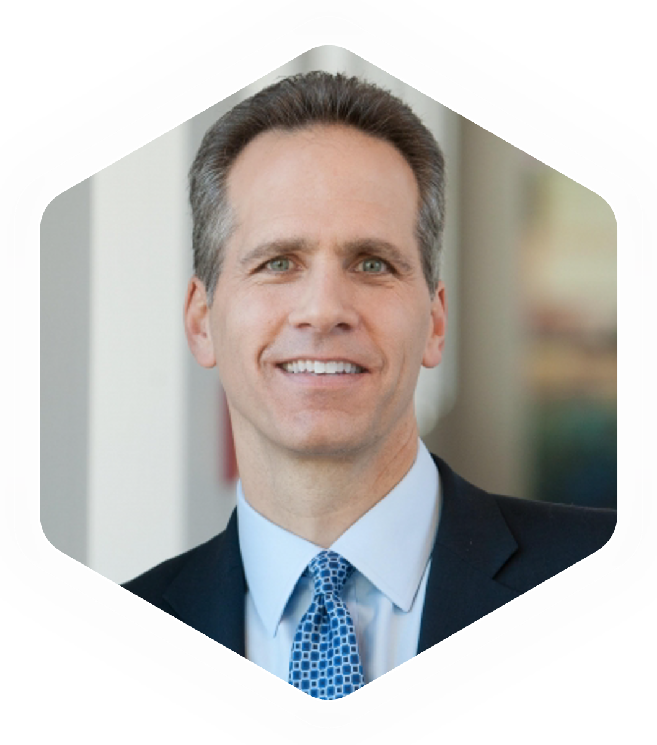
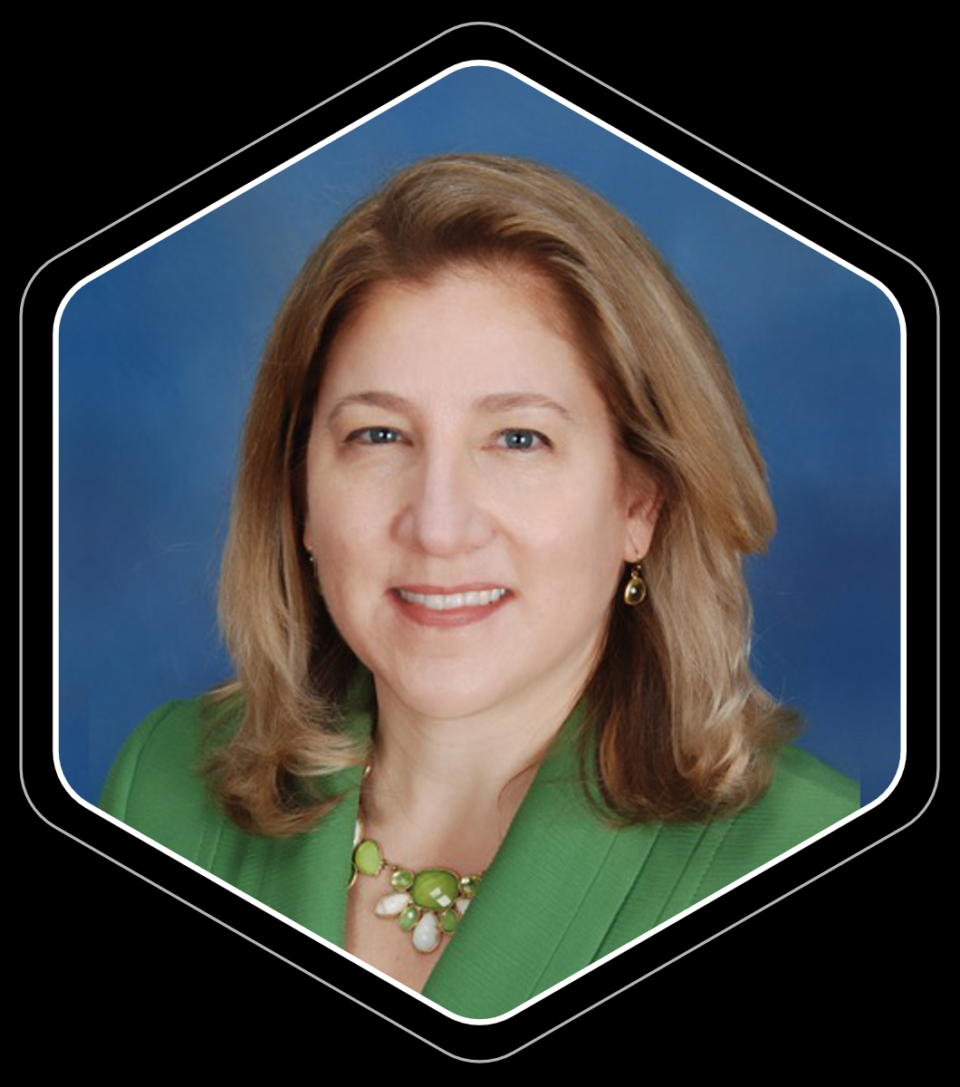
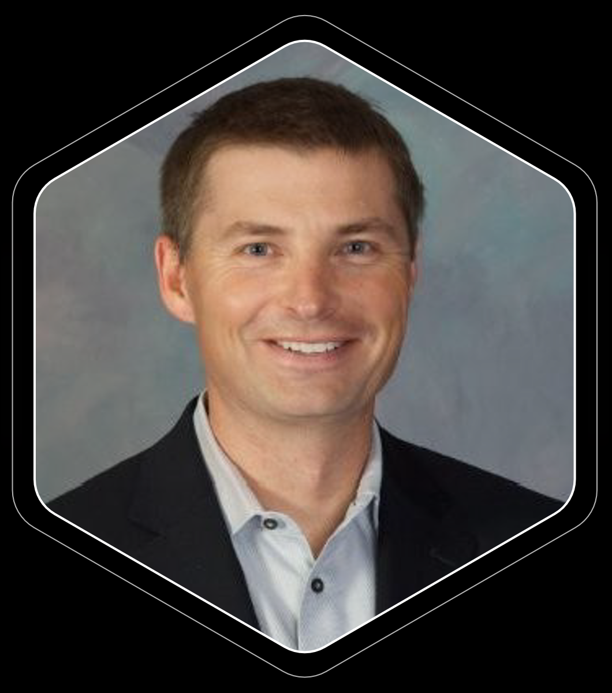
Using Intelligent Next Best Actions to Drive Personalized,
Proactive, Multi-Channel Patient Dialogue
Date: Monday, October 14, 2019 | Time: 9:40-11:25
PATRICK CHARMEL
KIRSTEN ANDERSON, MD
MICHAEL LINNERT
President & CEO
Senior Director of Clinical Solutions
CEO & Founder
Notes:
Your financial Disclosure statement will be on the bottom of this slide

Slide 3
OUTLINE
 | 01 | The Health System Imperative – Personalized and Multi-Channel Patient Engagement
 | 02 | Is Your Health System Set up for Patient Loyalty?
 | 03 | Building Blocks for Successful Data-Driven Personalized Dialogue – Five Areas of Actions
 | 04 | Impact of Successful Engagement

Slide 4
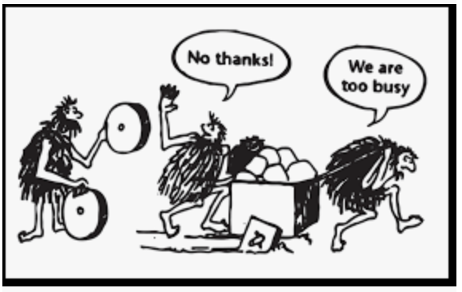
Personalized Patient Dialogue
When patients are actively engaged with their care, health systems enjoy improved clinician satisfaction, greater financial returns, and higher quality of care.
Health systems can unlock their valuable data to help clinicians engage patients in their health journey. This data can be formatted into next best actions which are used to promote a patient dialogue beyond the office visit.
We’re here to discuss how to think differently about patient engagement
Notes:
You can see here that the epidemic has evolved. First prescription opioids, then right around 2012, we see a big spike in heroin and fentanyl. What began to happen around 2012 that may have caused this spike? Let’s take a look.

Slide 5
Why Personalized and Multi-channel Patient Engagement?
Helps achieve our goals as health systems:
Moves metrics
(i.e. care gap closure, reducing leakage, lowering PMPM costs for at-risk populations, generating PCP revenue, and improving quality scores)
Drives to both better outcomes for
our patients and
happier providers
Creates a personalized dialogue for each patient and cares for that
patient in the space
between the office visits
Maximize physician retention, minimize physician burnout
Notes:
You can see here that the epidemic has evolved. First prescription opioids, then right around 2012, we see a big spike in heroin and fentanyl. What began to happen around 2012 that may have caused this spike? Let’s take a look.

Slide 6
Describing the Patient Journey of Healthcare
Health literacy
Patient preferences
Disease state
Demographics
1. Big data and storytelling: The necessary duo in healthcare
Fierce Healthcare, Oct 22, 2015 6:50pm, accessed online 8/20/19
Andrea J. Simon, PhD

Slide 7
Goal: Engagement, Service, and Loyalty
 | A lifetime of patient value. This is not a one-off patient experience
 | Delight the patient, who is also a consumer
 | 2 personal examples: Minor 1-day surgical procedure requiring general anesthesia: no follow up from surgeon, “call us when you need us” Flu 2017 Urgent Care Center visit: received a phone call the next day from the treating clinician

Slide 8
Is our health care system set up for patient loyalty?
 | Interest in, and demand for, urgent care clinics is growing rapidly. The number of clinics has ballooned from 6,946 in 2015 to 8,285 as of June 2018 $18 billion industry experts predict will grow 5.8% yearly
 | Urgent care clinics handle: 89 million patient visits each year, or more than 29 percent of all primary care visits in the country Nearly 15 percent of all outpatient physician visits
Faster, easier, cheaper
1. The Essential Role of the Urgent Care Center in Population Health 2019 Associtaion Report
Laurel Stoimenoff, CEO of the Urgent Care Association (UCA)

Slide 9
So why do patients stay with their PCP?
 | Convenience: Nearly two thirds of patients would switch providers for the ability to get an appointment quickly when they need it, according to Accenture. Patient experience: Connecting with patients Redefining quality: Quality may mean short wait times and walk-in hours Empowering consumers with wellness offerings
 | Attributes of current PCP and clinic (including access, service, quality, and reputation factors) Strength of current relationship (consumer likelihood to stay, follow, and recommend PCP)
Becker’s Hospital Review July 2018: https://www.beckershospitalreview.com/patient-engagement/how-to-build-loyalty-and-retain-patients-for-your-healthcare-system.html
Advisory Board Study in 2015: 1843-consumer nationwide survey

Slide 10
Engaged patients are required for improved health
Quality Care Actions Completed by Outpatient Teams
Contributing to improved Health System Performance
Contributing to Ambulatory Physician Satisfaction and Productivity
Call Center teams
Practice Based Teams:
Care Coordinators
Behavioral Health Clinicians

Slide 11
Extending the PCP: Right Work for the Right Staff
 | We can’t continue to ask PCPs to chase lists of preventive care gaps and other measures that insurers throw at them in value-based contracts
 | Need to consider productivity of workforce, clinicians and non-clinicians
 | Right – sizing of the work to be done: by whom, using what channel
 | Invigorated clinicians, who can rely on the team to achieve health goals = better morale, better reputation, stronger patient relationship
 | Value is more than revenue - health, delight, loyalty
BURNOUT:
What my Physicians will look like if I ask them to do one more thing

Slide 12
5
Areas of Action

Slide 13
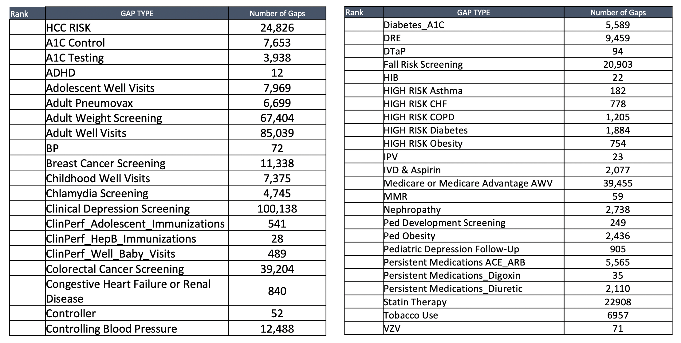
Action 1: Prioritize Engagement….because without it, you get this…
Bundled Payments
Capitated Payments
Quality Metrics
RAF Scoring
Fee for Service
Payer Incentives
Financial Targets
Appointment
Capacity
Elective Services
Millions of open care gaps, dozens of different systems telling you what to do with whom. OVERWHELMING.
We are told to engage the Healthy, At-Risk, and Sick

Slide 14
Action 2: Scale without Taxing Providers
Call back lists
New lists
New top priority lists
Care gap lists
This isn’t scaling. This is burden shifting!

Slide 15
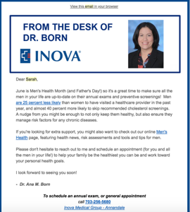
Action 3: Influence Consumer Behavior
 | Next Best Actions identify whom to engage, when to engage, what content will resonate, And what channel will likely lead to best conversion
 | Every industry but healthcare has figured this out
 | Dynamic personalization

Slide 16
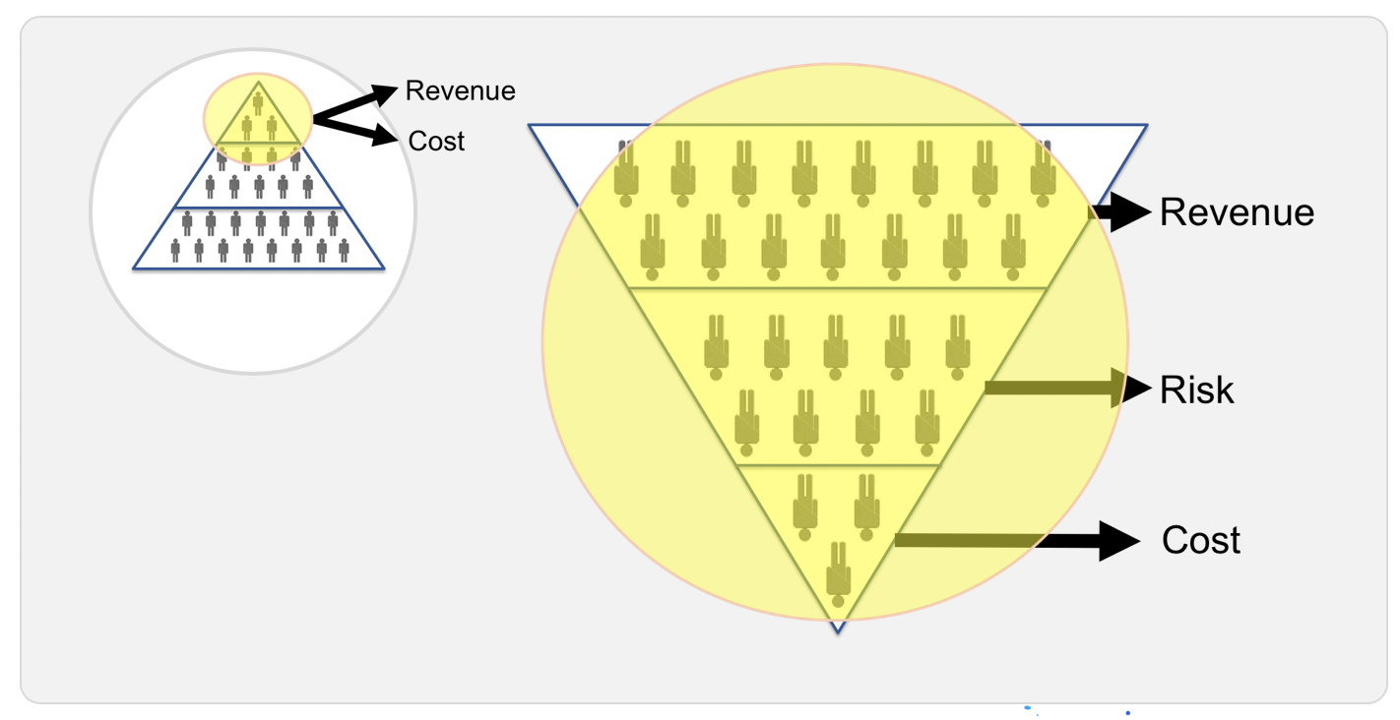
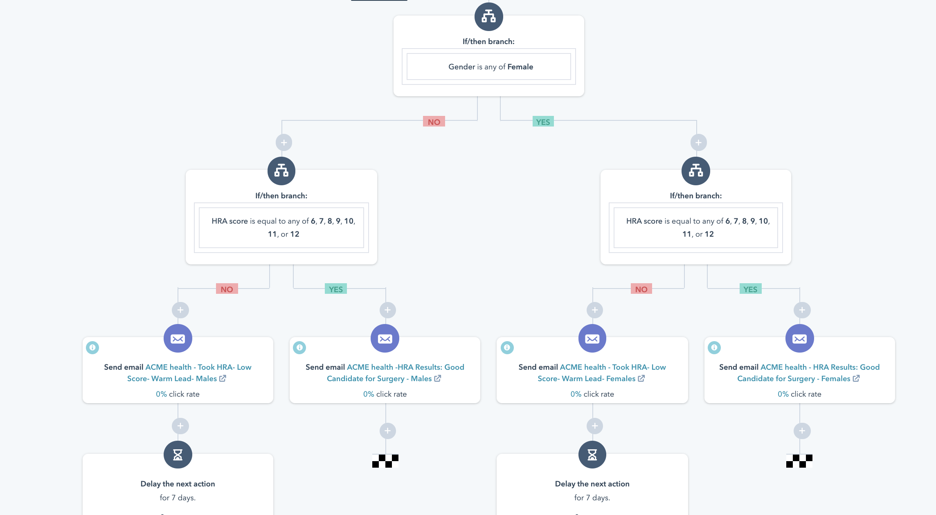
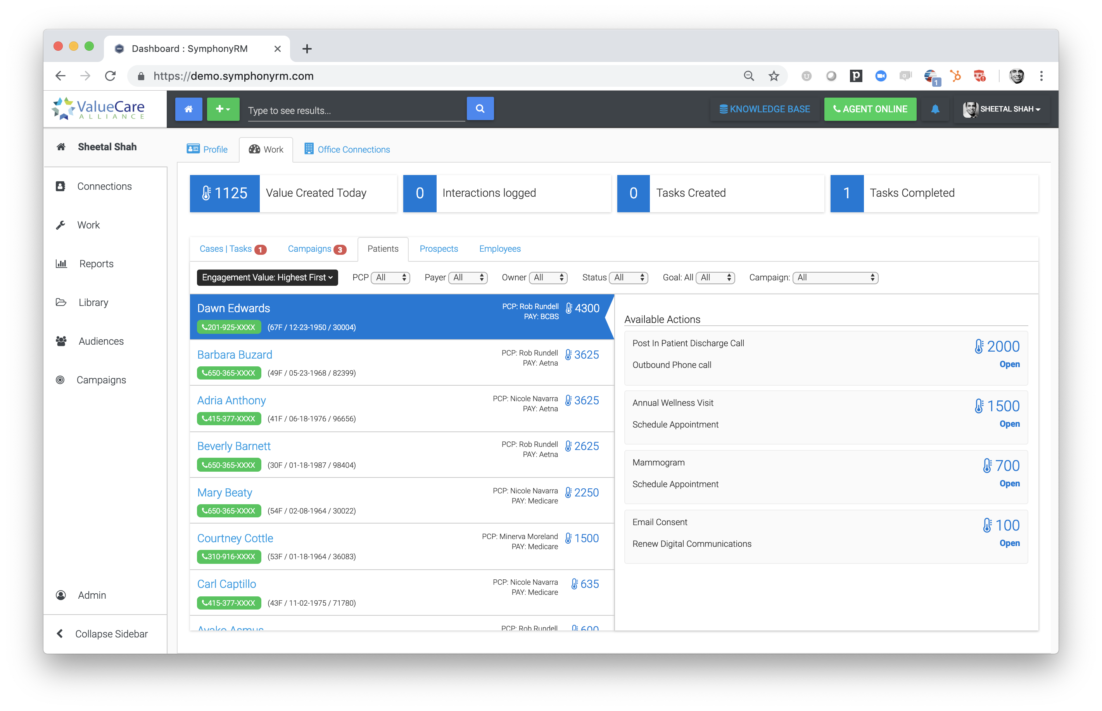
Action 4: Orchestrate the Complexity
Complexity is changing in scope
Utilize AI to craft engagement plans
Suddenly technology is working on behalf of the provider

Slide 17
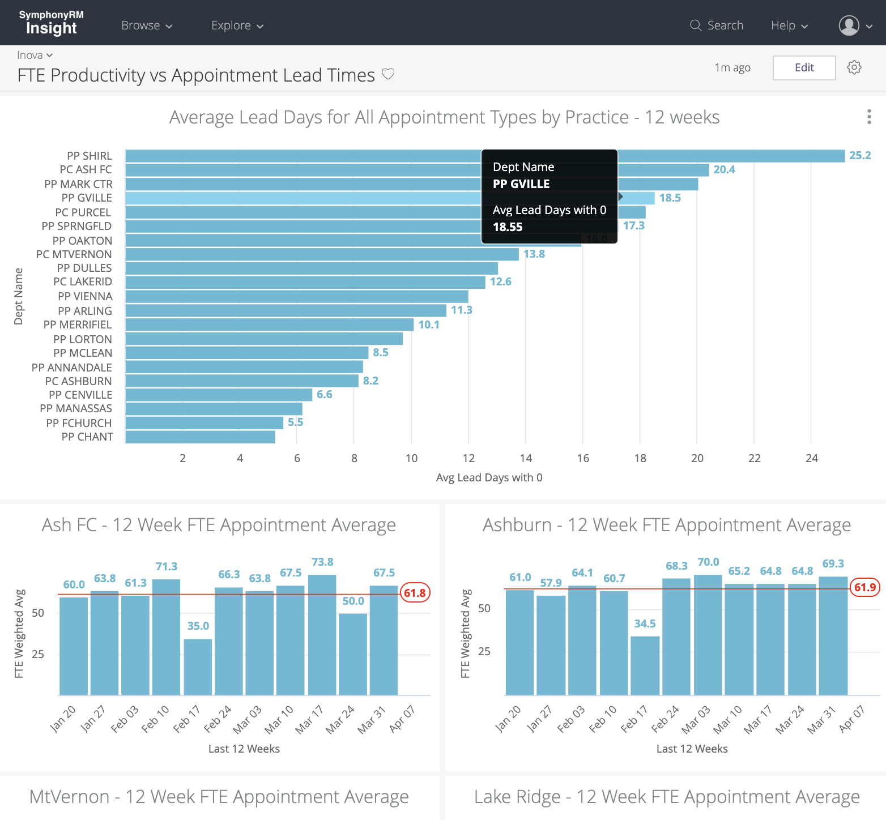
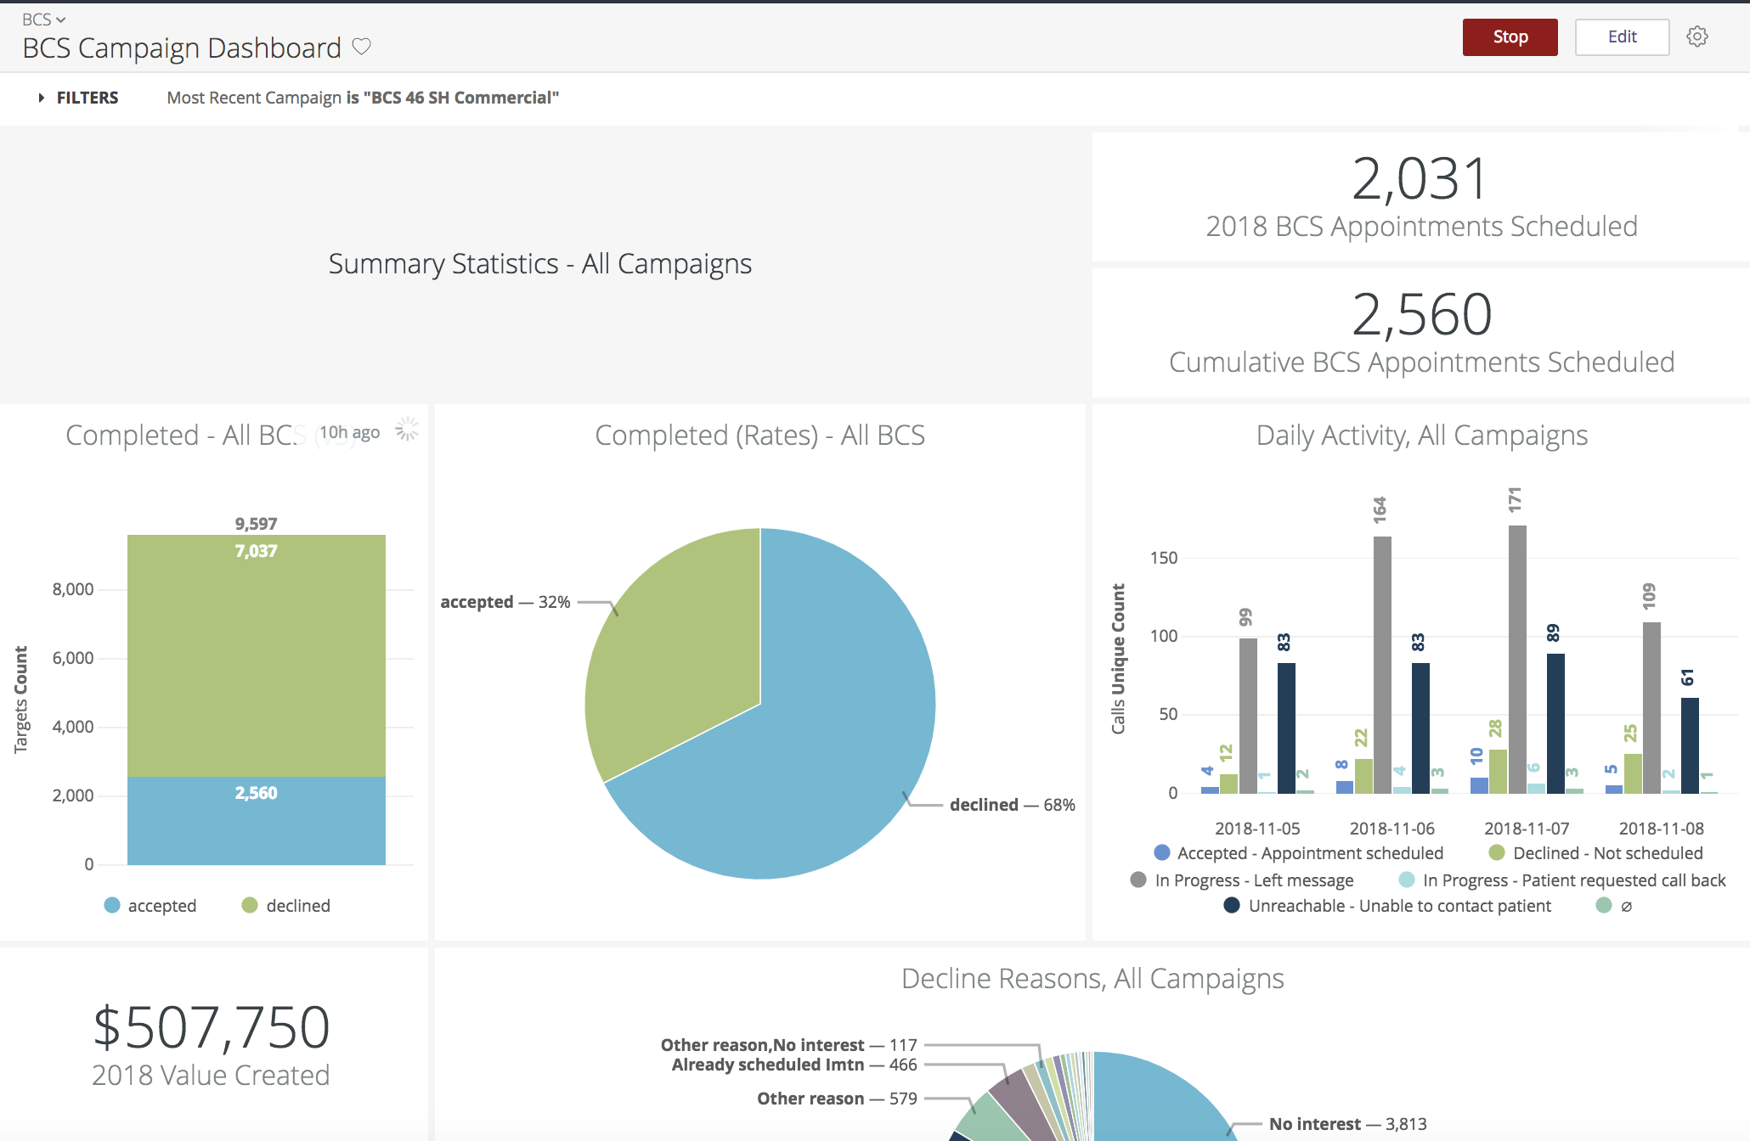
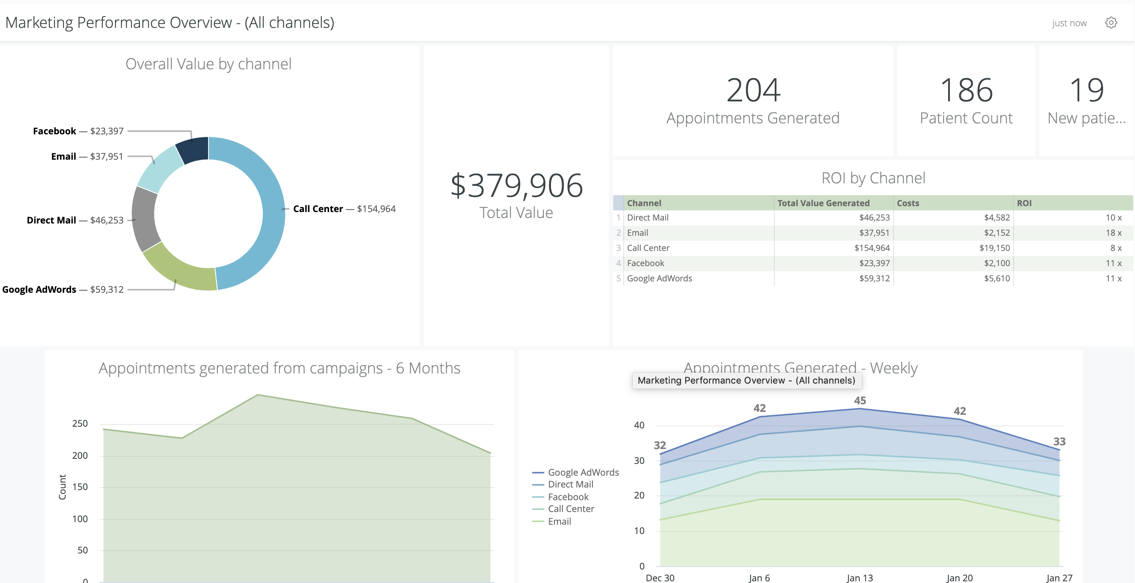
Action 5: Speed & Accountability

Slide 18
Five Areas of Action
Prioritize
Scale
Influence Behavior
Lots of reasons to engage consumers
Algorithms can determine value and dynamically score
Scale the Provider with AI
Remove provider burden, reduce burnout, and improve patient delight and quality
It's not the quadruple aim, it's the "obvious aim"
Healthcare’s biggest challenge
Luckily lots of work has been done in other industries
Orchestrate the Complexity
Speed
Scope and complexity growing
Utilize intelligent technology to navigate these waters directly with the consumer
Air traffic control view
Have to hold our people and technology accountable
If we don’t

Slide 19
Competition is Coming for Your Customers/Patients
They are
investing in (Y)our customers!

Slide 20
Defining and Measuring Success

Slide 21
Back to the Beginning: Next Best Actions
If we had had the privilege of speaking with one of our patients today, what is the most valuable thing we could ask them to do?
Baseline
FFS-VB
Quality
Cost
Improve Provider Productivity and Practice Profitability
Drive In Network Specialty Referrals and Downstream Revenue
Improve Accountable Care Quality Measure Performance
Reduce PMPM TCC (per member per month)

Slide 22
Primary Care Call Center
CALL
CENTER
1
SCHEDULING
NEW PATIENT
OR CAMPAIGN
2
LAB RESULTS
MD OFFICE
3
SCRIPTS
MD OFFICE
4
BILLING
BILLING
OFFICE
EXISTING
PATIENT
5
OTHER
CALL
CENTER
IVR

Slide 23
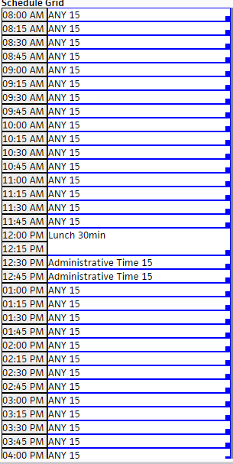
15/30 Template
 | New proposal for 15/30 minute template
 | 15 minute appointments Same Day Add On Prolonged Brief ER D/C New Acquaintance BP Check Diabetic Follow Up Add new Sick appointment type for appointments that aren’t booked same day

Slide 24
15/30 Template
 | 30 minute appointments CPE AWV New Patient Hospital D/C Transitional Care New Patient ER D/C New Patient Hospital D/C Pre Op

Slide 25
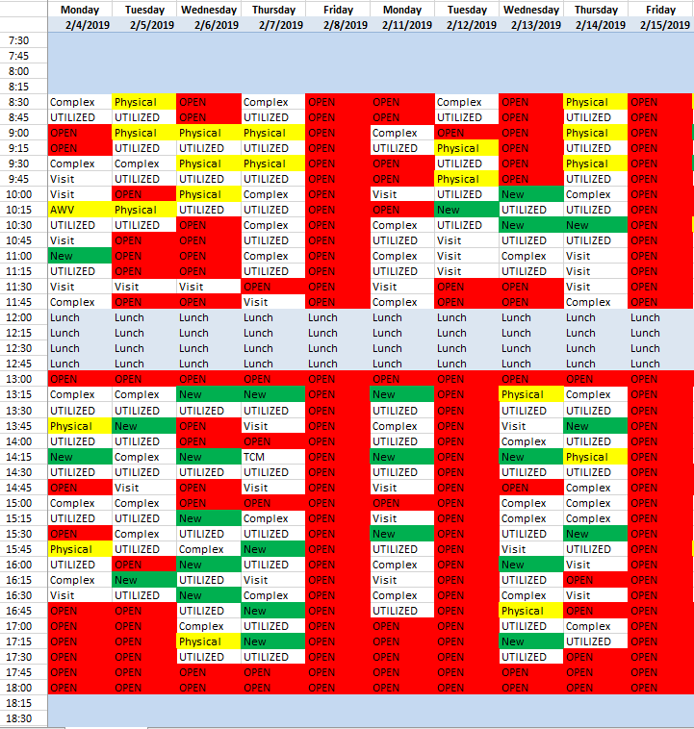
Dr. Chovitz

Slide 26
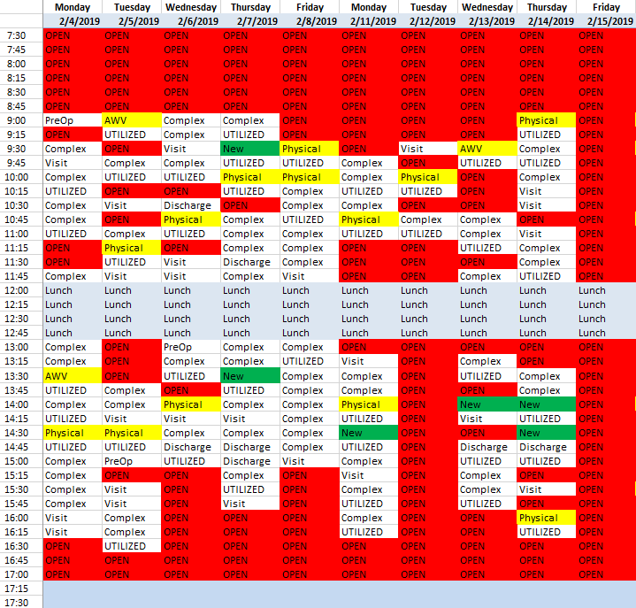
Dr. Felix

Slide 27
Next Best Actions Fuel Call Center Success
 | Average Value per Outbound Call Made: $44.58 - $79.35 AWV Conversion Rates: 16%-24% A1c Conversion Rates: 51-58%
 | $1.4 million incremental value – Increased Annual Wellness Visits lead to higher care gap closure rates, including services that contribute to downstream revenue

Slide 28
Models showed that if we targeted AWVs we saw significant closure of other care gaps
Colonoscopy Every Five Years
Shingles Immunization Age 60+
DM Ophthalmology Exam
Pneumonia Vaccine Age 65+
Influenzas Vaccine
Depression Screening
Mammogram
PCMH Care Plan Letter
Falls Risk Annual
Colonoscopy Ten Years
Patients with open AWVs (N)
Closed Care Gap % of Patients with AWVs (Y)
00%
20%
40%
60%
80%
100%

Slide 29
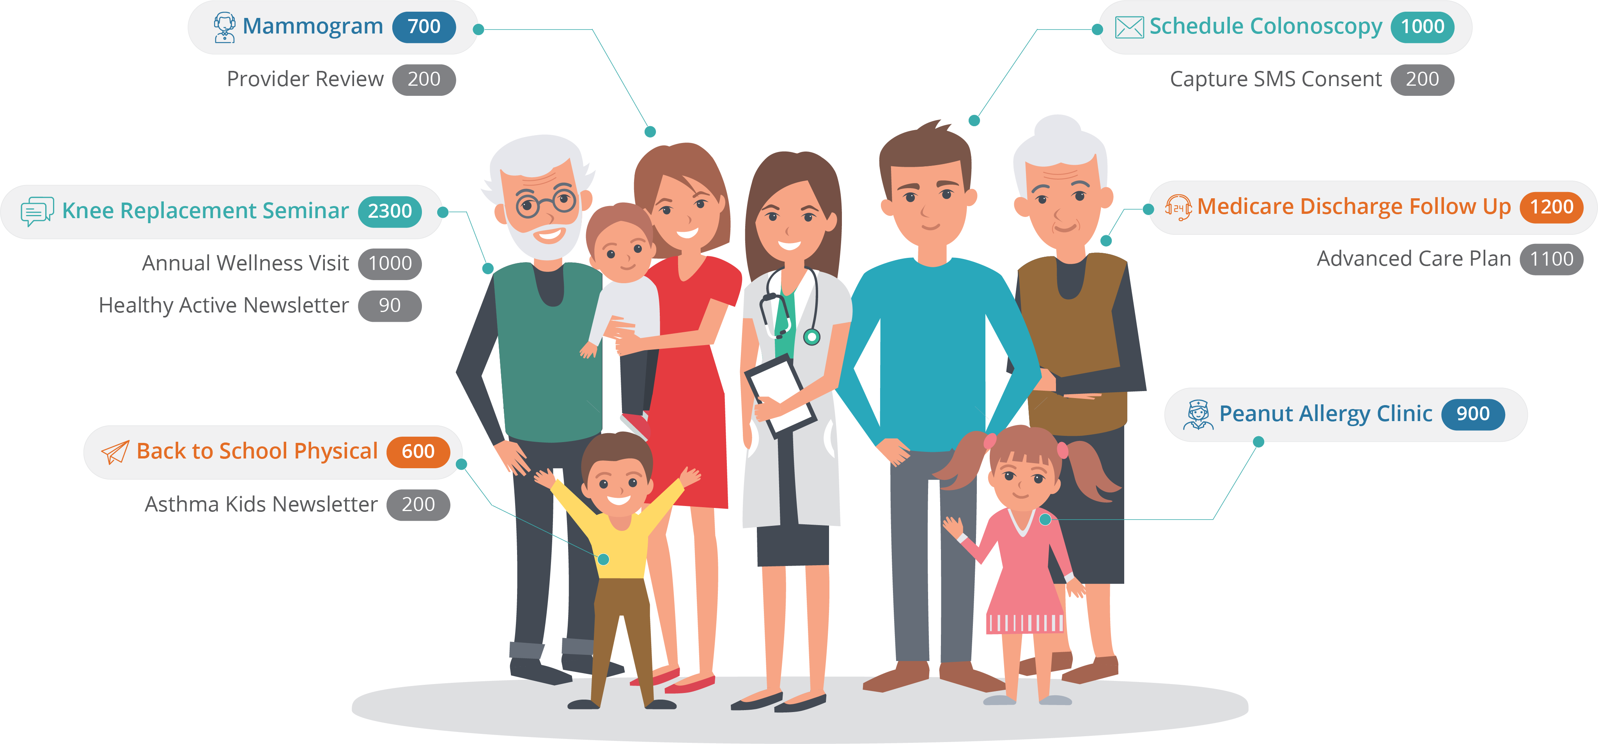
Traditional Marketing
Next Best Action Marketing

Slide 30
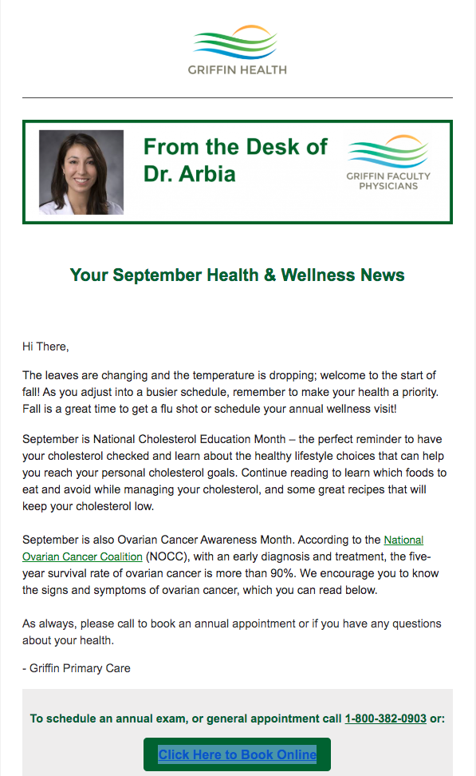
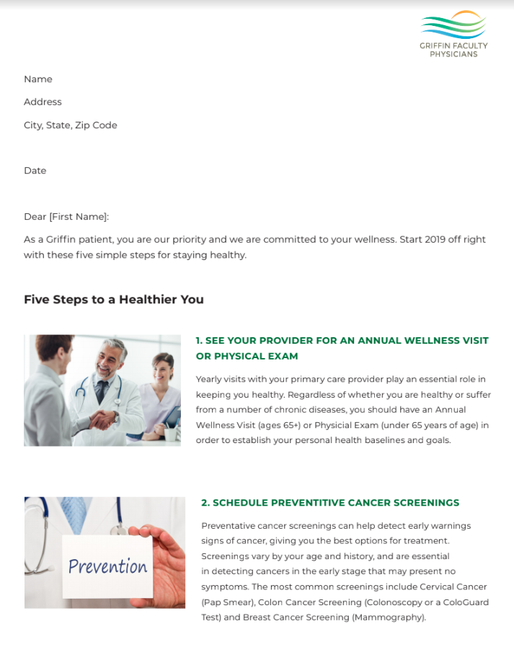
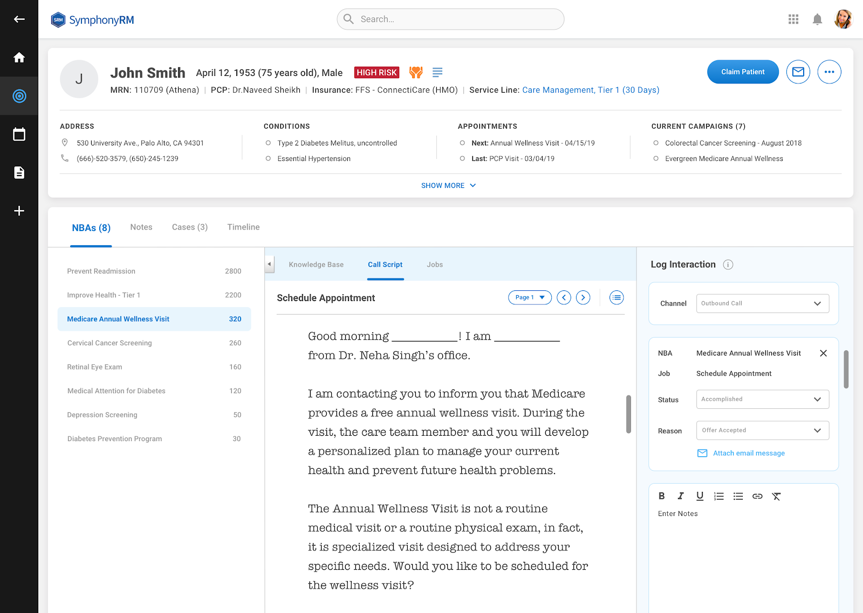
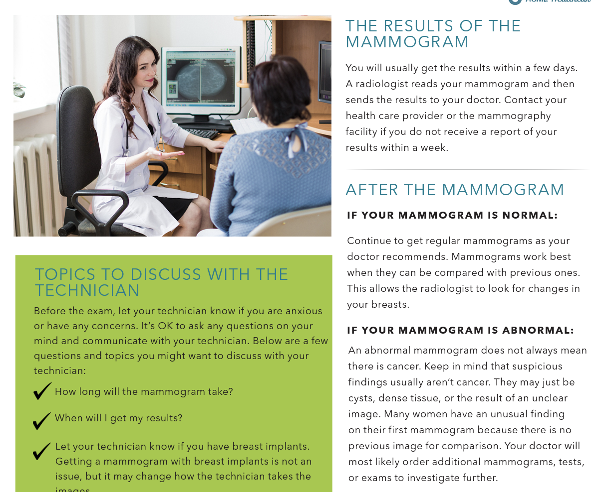
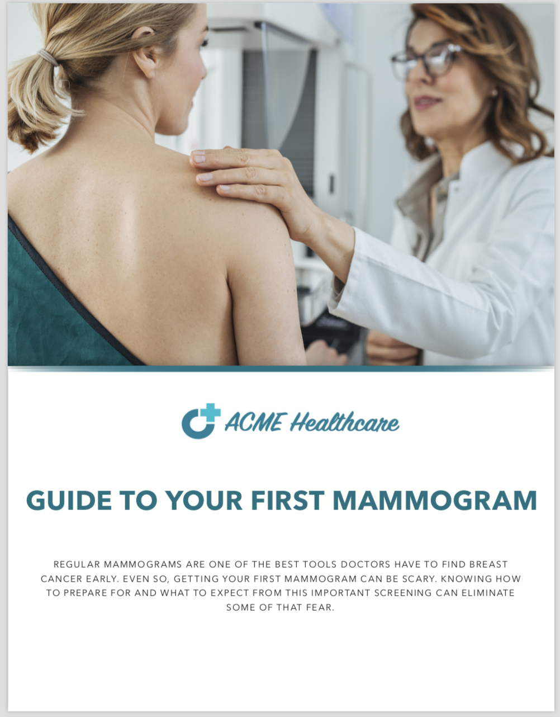
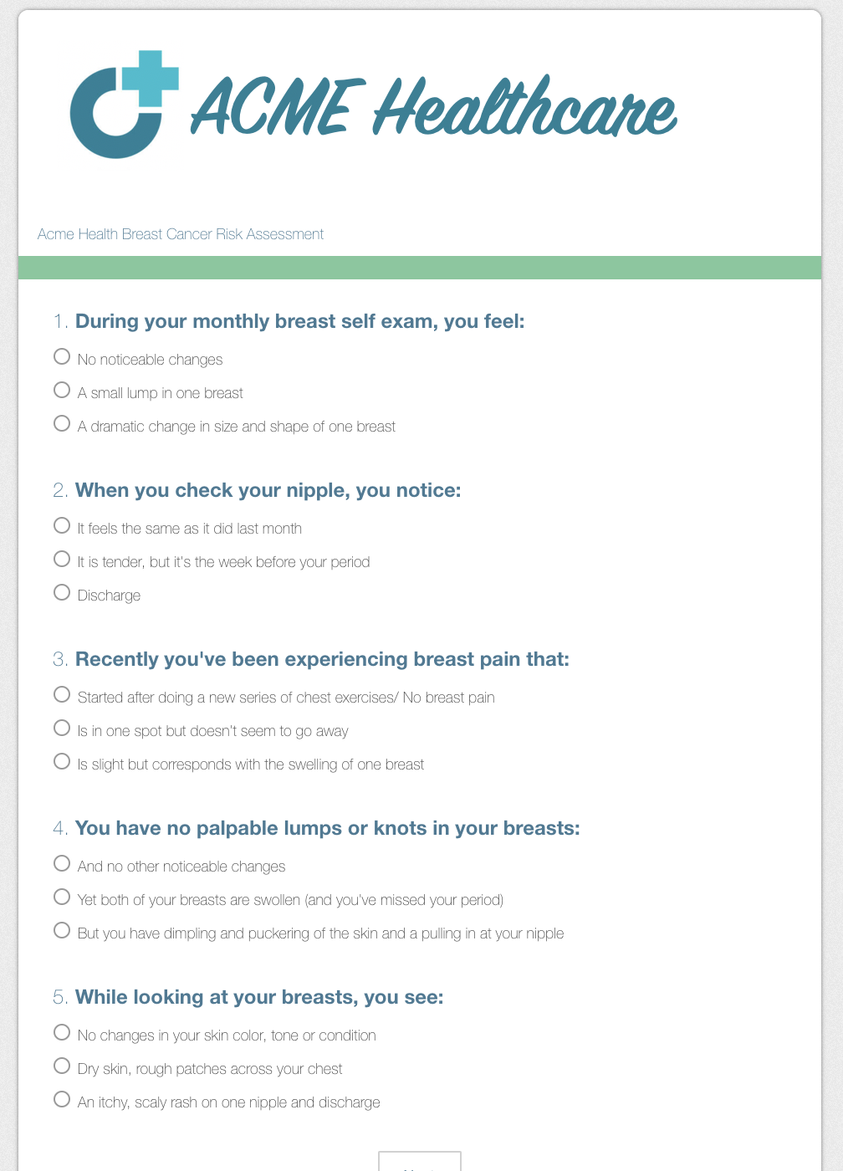
Multi-channel Content Drives Dialogue and Influences Action

Slide 31
A Look at Newsletter Performance: Customization Drives Impact
Inject Next Best Actions into Patient Newsletters
 | Total | Appts | Appt % |  | Appts Over Baseline | Appt Value
Group: Control without Personalization | Open | 41,000 | 3,432 | 8.40% | 678 | $74,591
 | Unopen | 101,000 | 6,784 | 6.70%
 | Open % | 29%
Personalized with Dr. G Email Header | Open | 165 | 20 | 12.10% | 9 | $981
 | Unopen | 244 | 20 | 8.20% | 4 | $397
 | Open % | 40%
Personalized with Dr. L Email Header | Open | 672 | 76 | 11.30% | 31 | $3,395
 | Unopen | 882 | 71 | 8.00% | 12 | $1,293
 | Open % | 43%
Personalized with Dr. W Email Header | Open | 674 | 65 | 9.60% | 20 | $2,170
 | Unopen | 808 |  | 5.20%
 | Open % | 45%

Slide 32
Content Drives People to Book Appointments
Customized newsletters conversion rates were as high as 14.8% and averaged 8.6% (vs. 4.5% for non-customized)
Appointment revenue generated in May: $27,610 (highest month to date)
Healthcare system starts using SRM’s data-proven content

Slide 33
More Than One Year Later: Appt Conversion Rates Still High
Average monthly appointment revenue from newsletters: $44,930

Slide 34
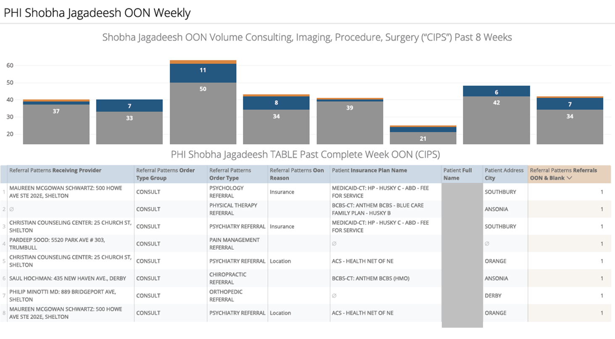
Utilizing Data Analytics in Managing Patients

Slide 35
Technology and Data Impacting Service Delivery

Slide 36
GFP – Improving Provider Profitability

Slide 37
Western Connecticut Health Network Q4 2018 Quality
claims thru 12/31/2018
Measure Grouping/ Measure Number | Measure Short Description | Denominator | Numerator | 1Q 2018 | 2Q 2018 | 3Q 2018 | Results thru 9/30/2018 | Baseline | Aetna National Average | CT Mean | 10% | 20% | 30% | 40% | 50% | 60% | 70% | 80% | 90% | 100%
Cancer Screening/ 100360 | Breast cancer screening (UPDATED) | 1,800 | 1,574 | 87.42% | 88.64% | 86.41% | 87.44% | 88.78% | 84.59% | 91.65% | 87.00% | 87.25% | 87.50% | 87.75% | 88.00% | 88.25% | 88.50% | 88.75% | 89.00% | 89.25%
Cancer Screening/ 100364 | Cervical cancer screening (UPDATED) | 3,208 | 2,910 | 92.72% | 92.62% | 89.92% | 90.71% | 92.80% | 87.05% | 93.94% | 91.00% | 91.25% | 91.50% | 91.75% | 92.00% | 92.25% | 92.50% | 92.75% | 93.00% | 93.25%
Diabetes/ 100024 | Diabetes: Hemoglobin A1c testing | 532 | 492 | 89.75% | 93.46% | 91.67% | 92.48% | 92.23% | 92.55% | 94.91% | 91.00% | 91.25% | 91.50% | 91.75% | 92.00% | 92.25% | 92.50% | 92.75% | 93.00% | 93.50%
Diabetes/ 100160 | Diabetes: Medical attention for nephropathy | 465 | 440 | 96.02% | 95.83% | 92.81% | 94.62% | 94.59% | 96.27% | 97.08% | 93.25% | 93.50% | 93.75% | 94.00% | 94.25% | 94.50% | 94.75% | 95.00% | 95.25% | 95.50%
Diabetes/ 100016 | Diabetes: Retinal eye exam | 516 | 228 | 44.73% | 53.42% | 44.58% | 44.19% | 51.08% | 43.53% | 66.66% | 50.00% | 50.25% | 50.50% | 50.75% | 51.00% | 51.25% | 51.50% | 51.75% | 52.00% | 52.25%
Persistent Medication/ 100128 | ACE-I/ARB: Persistent use with lab monitoring | 510 | 465 | 90.15% | 88.30% | 88.27% | 91.18% | 89.85% | 89.03% | 94.87% | 88.00% | 88.25% | 88.50% | 88.75% | 89.00% | 89.25% | 89.50% | 89.75% | 90.00% | 90.25%
Top 4 ranked Quality
Measures are scored
Quality Adjusted Percentage= 60 %
Total Population through
December 2018 = 15,626

Slide 38
Griffin Q4 2018 Quality
claims thru 12/31/2018
Measure Grouping/ Measure Number | Measure Short Description | Denominator | Numerator | 1Q 2018 | 2Q 2018 | 3Q 2018 | Results thru 12/31/2018 | Baseline | Aetna National Average | CT Mean | 10% | 20% | 30% | 40% | 50% | 60% | 70% | 80% | 90% | 100%
Cancer Screening/ 100360 | Breast cancer screening (UPDATED) | 223 | 202 | 89.69% | 90.59% | 89.55% | 90.58% | 88.78% | 84.59% | 91.65% | 87.00% | 87.25% | 87.50% | 87.75% | 88.00% | 88.25% | 88.50% | 88.75% | 89.00% | 89.25%
Cancer Screening/ 100364 | Cervical cancer screening (UPDATED) | 425 | 388 | 90.75% | 91.20% | 92.29% | 91.29% | 92.80% | 87.05% | 93.94% | 91.00% | 91.25% | 91.50% | 91.75% | 92.00% | 92.25% | 92.50% | 92.75% | 93.00% | 93.25%
Diabetes/ 100024 | Diabetes: Hemoglobin A1c testing | 131 | 125 | 95.88% | 95.50% | 98.20% | 95.42% | 92.23% | 92.69% | 94.91% | 91.00% | 91.25% | 91.50% | 91.75% | 92.00% | 92.25% | 92.50% | 92.75% | 93.00% | 93.50%
Diabetes/ 100160 | Diabetes: Medical attention for nephropathy | 122 | 116 | 91.30% | 92.59% | 96.33% | 95.08% | 94.59% | 96.25% | 97.08% | 93.25% | 93.50% | 93.75% | 94.00% | 94.25% | 94.50% | 94.75% | 95.00% | 95.25% | 95.50%
Diabetes/ 100016 | Diabetes: Retinal eye exam | 126 | 64 | 44.79% | 55.14% | 53.33% | 50.79% | 51.08% | 43.70% | 66.66% | 50.00% | 50.25% | 50.50% | 50.75% | 51.00% | 51.25% | 51.50% | 51.75% | 52.00% | 52.25%
Persistent Medication/ 100128 | ACE-I/ARB: Persistent use with lab monitoring | 130 | 121 | 89.38% | 90.52% | 92.11% | 93.08% | 89.85% | 88.94% | 94.87% | 88.00% | 88.25% | 88.50% | 88.75% | 89.00% | 89.25% | 89.50% | 89.75% | 90.00% | 90.25%
Top 4 ranked Quality
Measures are scored
Quality Adjusted Percentage= 95%
Total Population through
December 2018 = 1,747

Slide 39
The Future of Healthcare

Slide 40
Thank You!
Notes:
Your financial Disclosure statement will be on the bottom of this slide

